Slide 1
University Event Database
OPIM 5272 - BPMDM| Team 5

Slide 2
Agenda
Overview
Current Process
Issues with current process
Proposed future process
Data Model
Database & Portal Demo
Conclusion
Appendix

Slide 3
Overview
University Event Database is an enterprise database that can be used by an educational institution to automate their event handling process
This project is inspired by problems faced by existing event handling process at VIT
University event database simplifies by making use of efficient data management techniques

Slide 4





Existing Process
Contact Help Desk
Registration
Confirmation
Payment
Step 1
Step 2
Step 3
Step 4
Student request and Help desk representative
Helpdesk Person verifies students identify
Help Desk Associate communicates to the event-coordinator
Event Coordinator confirms seat availability
Generated Student’s ID for the event
Send email for confirmation to availability
Event Organizer receives the application
Event organizer signs and confirms the participation
Student Coordinator 2 receives payment from student manually
Student coordinator confirms id for the participant and confirms his participation
Student
Help desk
Help desk
Student coordinator 1
Student coordinator 1
Event Organizer
Student Coordinator 2

Slide 5
Issues with Current Process
Slow & Time Consuming
Involves Paperwork
Dependency Coordination
Not Instantaneous
Does not support analytics

Slide 6


New Process
Tableau Reports
Real-Time Reports
University Event Database
SQL Reports
Information sharing between website and DB
Student visits the website search information
Student registers for the open events
Event managers can enter details about upcoming events
Website triggers emails to student and event organizers upon completion

Slide 7
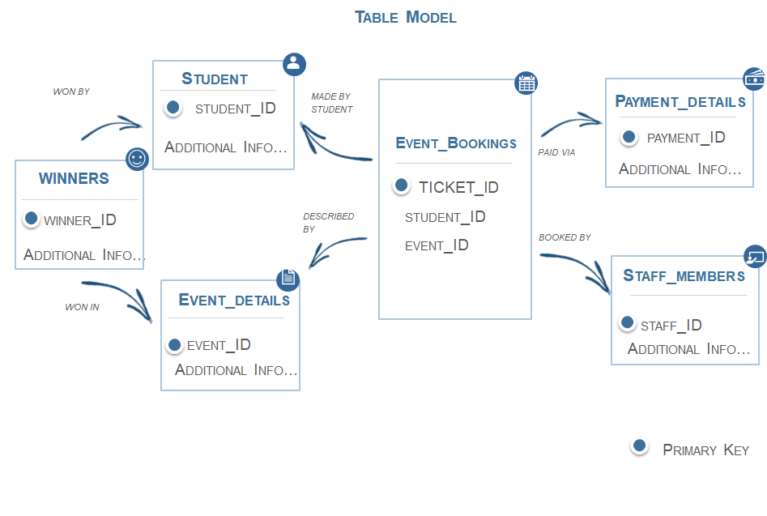
Data Model

Slide 8
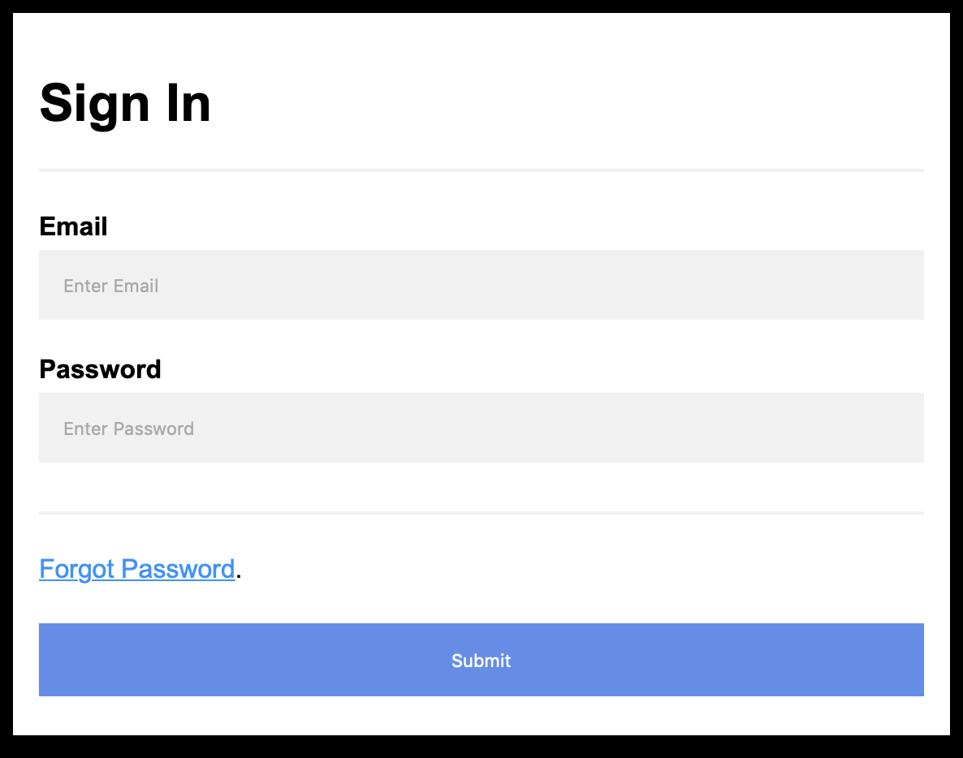
Online Portal
On clicking submit we will ensure two conditions:
Check if email exists
Confirm Password
On Hitting Submit following will be DB call:
create or replace FUNCTION student_validation(studentid IN NUMBER)
RETURN VARCHAR2
IS STD_CNT number;
BEGIN
SELECT COUNT(*)
INTO STD_CNT
FROM student STD
WHERE STD.email_address = &Email;
and STD.pwd = &pwd;
RETURN(STD_CNT);

Slide 9
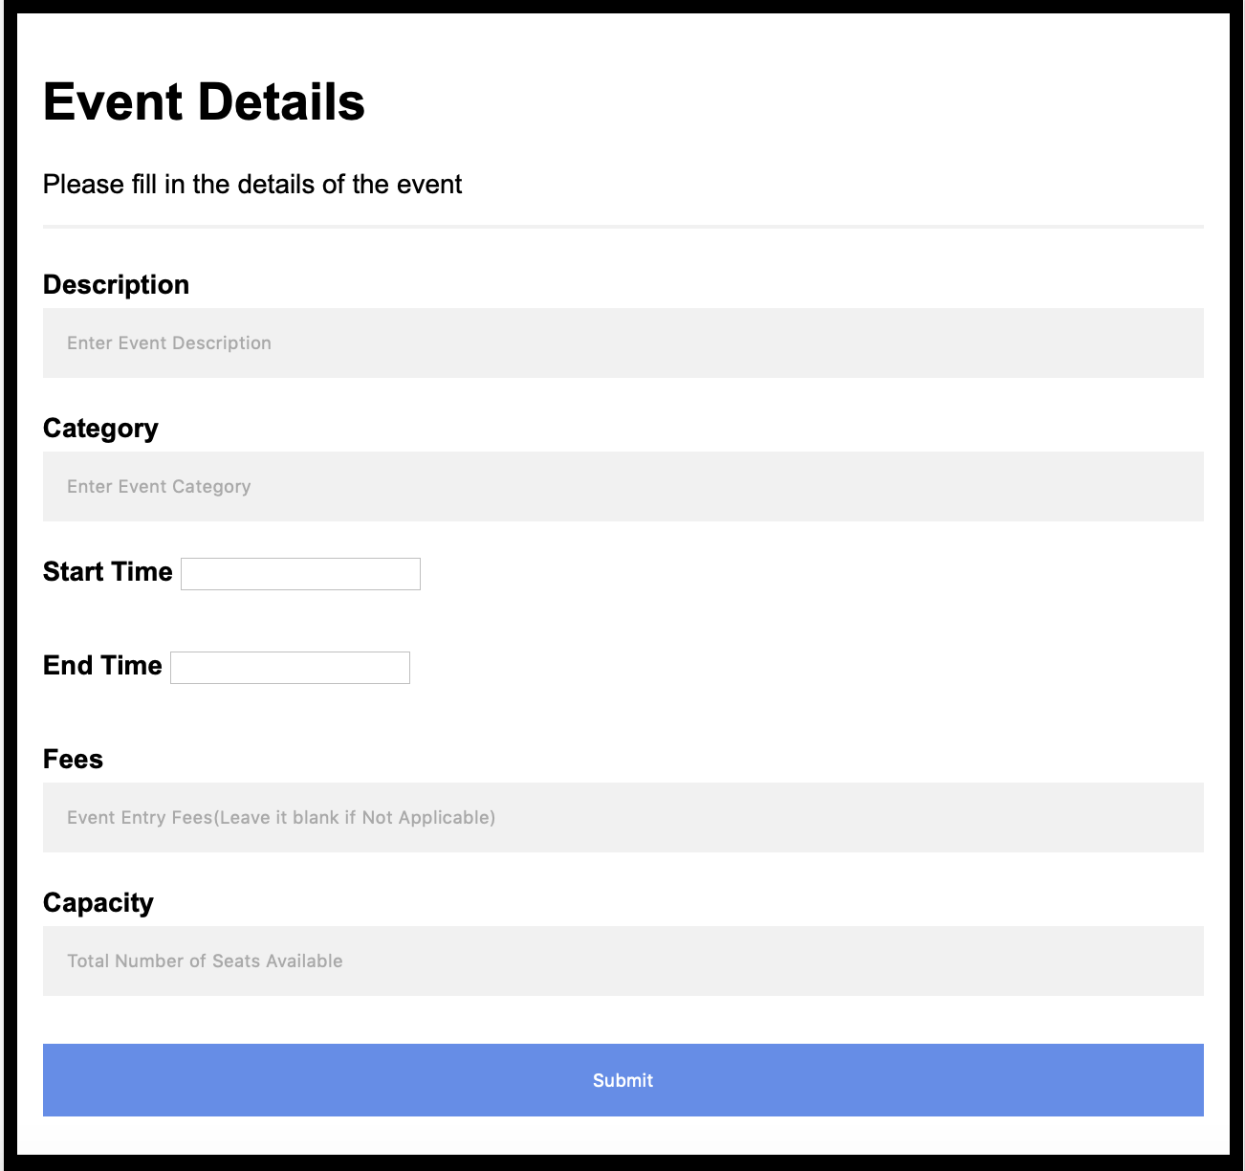
Event Details
Event Coordinator will use this form to enter the event details
On Hitting Submit following will be DB call:
exec Insert_Event_Data ('Lunch n Learn','54','26-Nov-2018 8:00:00 PM','',80,50,'Educational','26-Nov-2018 8:00:00 PM');

Slide 10
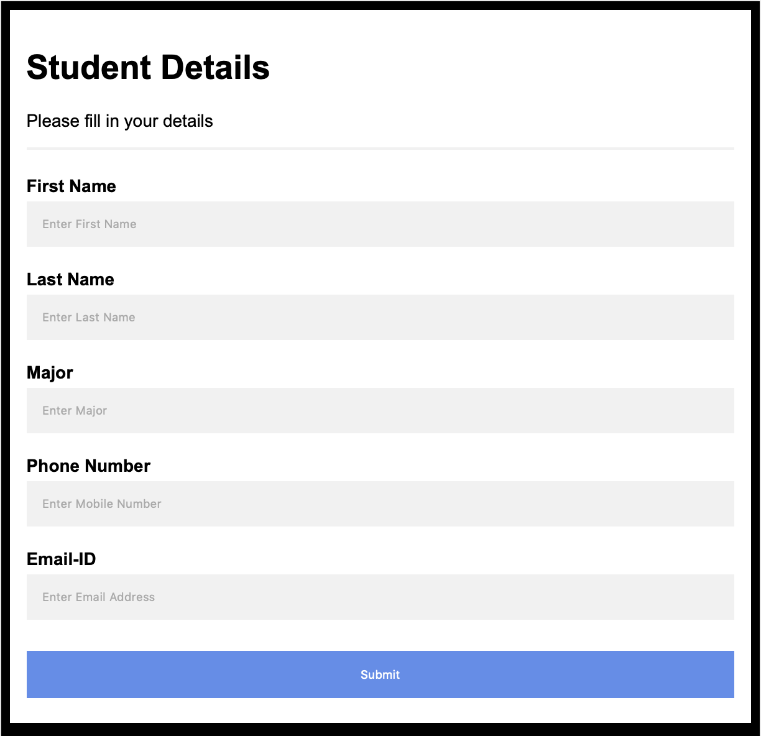
Student Details
We will by default mark that the student is active on registration
On Hitting Submit following will be DB call:
Exec Insert_stu_data ( 'Ankit','Bhardwaj','Information Technology','8608561836','ankit.bhardwaj@uconn.edu','Y');

Slide 11
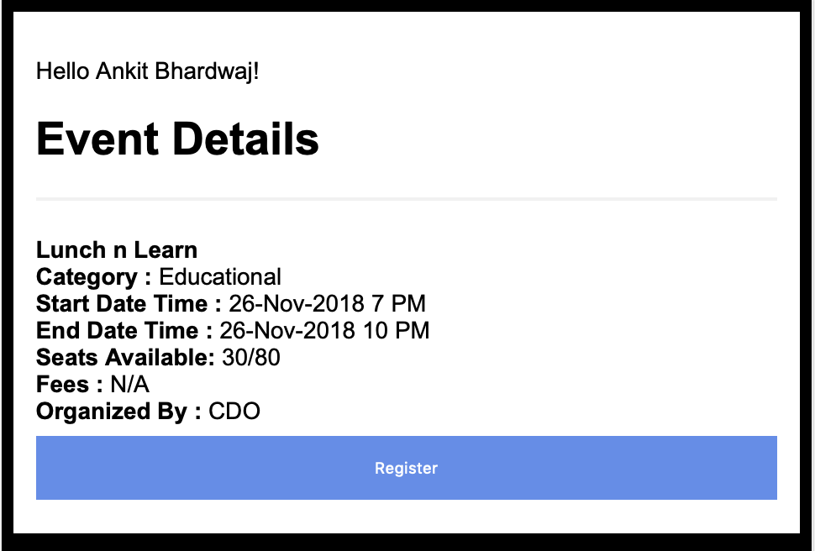
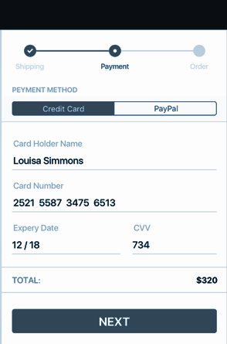
Event Booking
Check if
Active Registered Student is registering
Seats are available
Payment has been made if required
On Hitting Submit following will be DB call:
Exec Issue_Ticket (21,1);
# studentID, EventID
Payment Screen

Slide 12
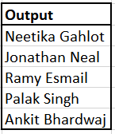
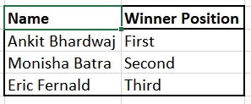
Operational Report Samples
select distinct First_name || ' ' || last_Name from Event_Bookings a , student b , event_details_1 c
where a.event_id = c.event_id and b.student_id = a.student_id and event_description = 'Key Note'
select First_name || ' ' || last_Name, Winner_Position from winners a, student b
where a.student_id = b.student_id and event_id = 3
-for more info…List location or contact for specification (or other related documents)

Slide 13
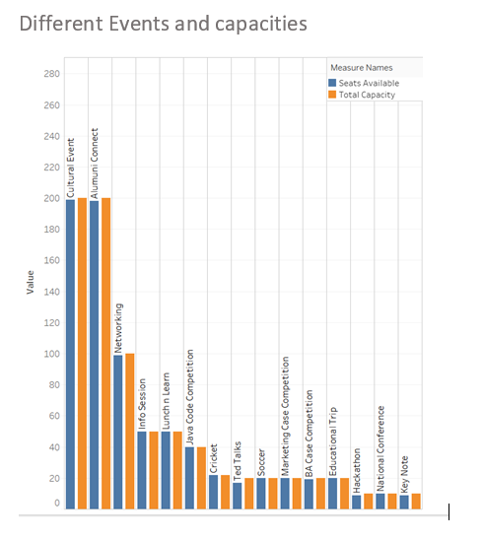
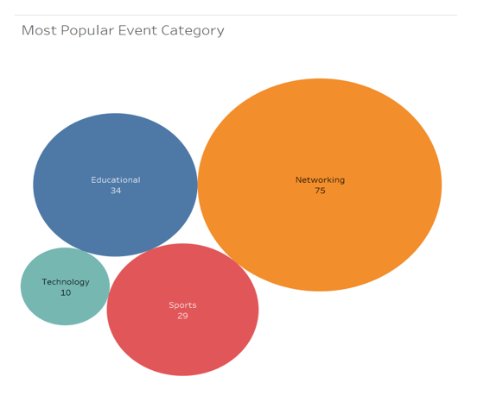
Analytics Report Sample

Slide 14
Conclusion
Cost Saving
Dependency
Threading
Convenience(time constraint)
Consistency
Target Audience and saving marketing effort(10,000 students at one time)

Slide 15
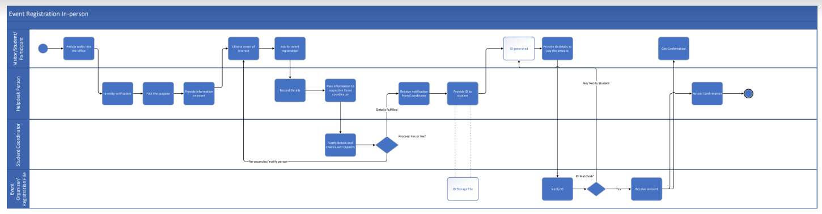
Appendix
AS IS Diagram

Slide 16
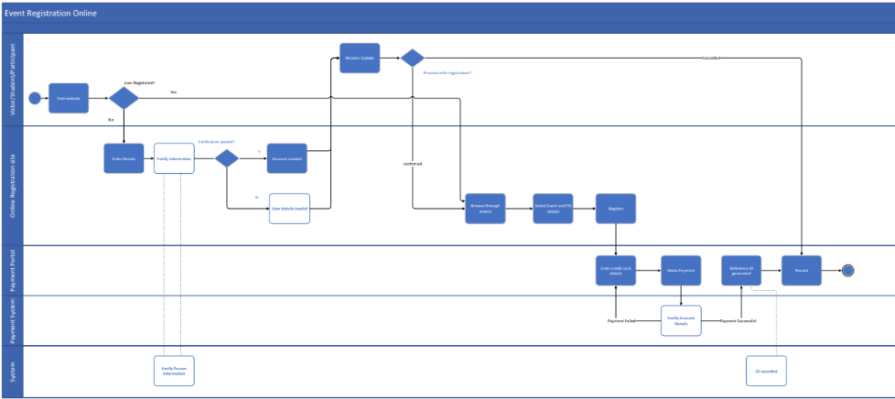
TO BE Diagram

Slide 17
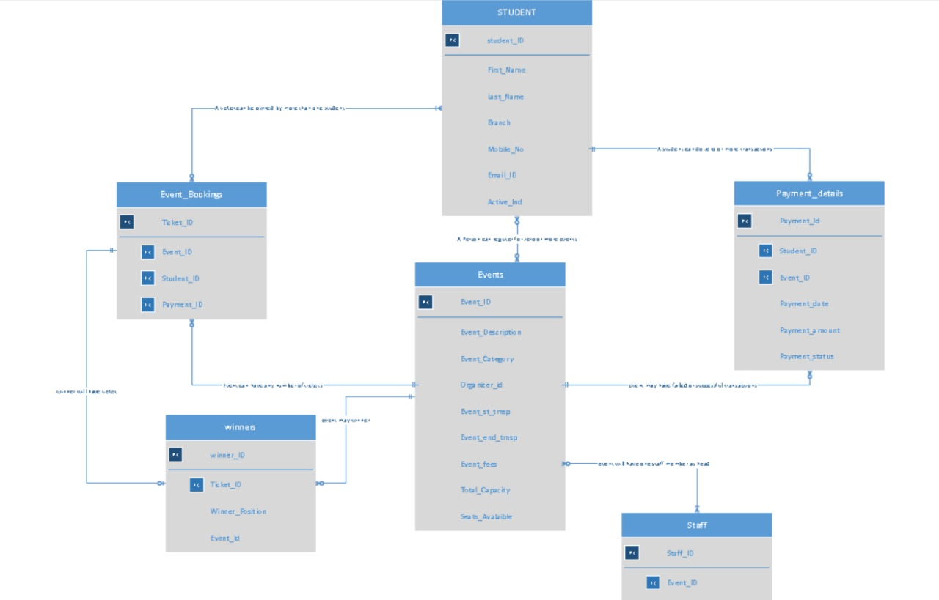
Data Model

